Slide 1
Sub-pixel CNN Based Color Image Demosaicing
Venkatesh Satagopan
Chair of Media Technology
Final Master Thesis Presentation
27-06-2019

Slide 2
Agenda
Introduction
Motivation
Original 3-stage Structure
Sub-pixel based Structure
Experiments
Experiments on Network Model
Experiments on Datasets
Self-ensemble Algorithm
Comparison of Models
Conclusions & Future plans

Slide 3
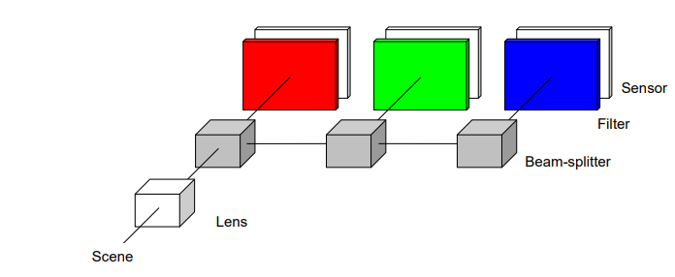
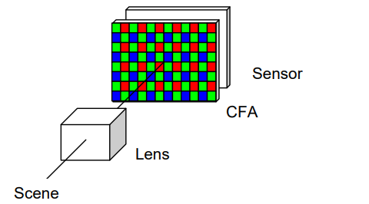
Introduction
What is Image demosaicing?
Algorithm to reconstruct a full color image from mosaiced(incomplete color) samples obtained from color-filter array covered sensors .
[1] Image source: LI, X., GUNTURK, B., AND ZHANG, L. 2008. Image demosaicing: A systematic survey. In Electronic Imaging 2008, International Society for Optics and Photonics, 68221J–68221J.
Notes:
Consider you are hosting a party and you want to capture the memories of the party so you capture amazing moments of it through camera application of your smartphone or DSLR camera. Ideally when you click a photo, the process that happens first is shown here. Light signal of the scene is focussed through lens and it is passed to first beam splitter. Beam splitter passes the light to sensor and to its adjacent beam splitter. Red, blue, green component of light is filtered through appropriate filter and reaches sensor which produces voltage signal corresponding to incident light signal. The obtained voltage is converted to digital signal through A/D converter and passed to further stages of image processing pipeline like compression and finally a digital copy of the image is stored in our phone. But in reality the process of getting light signal till sensor is little different. As shown in the figure most of our smart phones have a single image sensor not three sensors and we don’t have separate color filters for each color rather we have a color filter array which consists of series red,green,blue filters before the sensor. So the output of A/D converter will be a single channel image and not a three channel image, because we can capture either red , green or blue component of the image at a time. In short we miss 2 channel information per pixel at a time. So the process of reconstructing a 3 channel color image from a single channel mosaiced image is known as demosaicing.

Slide 4
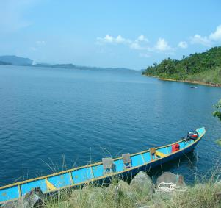
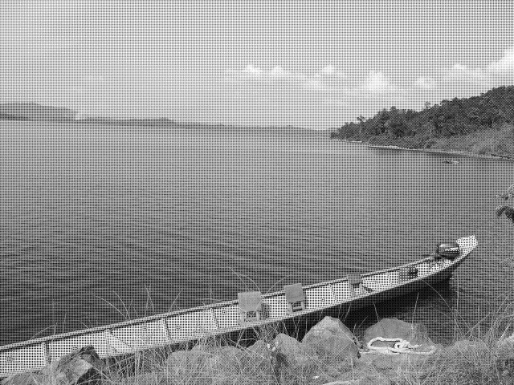
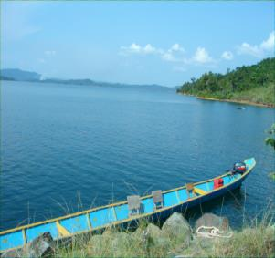
Introduction
Example
Original Image
Mosaiced Image
Demosaiced Image
[2] original image source: Waterloo Exploration Database: New Challenges for Image Quality Assessment Models

Slide 5
Agenda
Introduction
Motivation
Original 3-stage Structure
Sub-pixel based Structure
Experiments
Experiments on Network Model
Experiments on Datasets
Self-ensemble Algorithm
Comparison of Models
Conclusions & Future plans

Slide 6
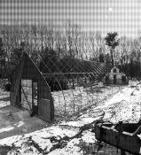
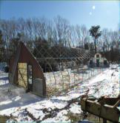

Motivation
Why we need good demosaicing algorithm ?
Demosaiced images obtained by interpolation methods causes unwanted artifacts mainly in high frequency regions of image.
Output of Demosaicing affects further stages in Image processing pipelining.
Initial interpolated image
CFA image
Bilinear interpolated image
Demosaiced image
Reconstruction
Filters
Bi-linear interpolation
Deep-neural network
Deep-neural network

Slide 7
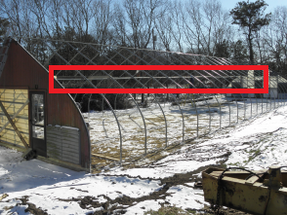


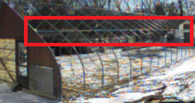
Motivation
Original image
Demosaiced image
[4] original image: Waterloo Exploration Database: New Challenges for Image Quality Assessment Models

Slide 8
Agenda
Introduction
Motivation
Original 3-stage Structure
Sub-pixel based Structure
Experiments
Experiments on Network Model
Experiments on Datasets
Self-ensemble Algorithm
Comparison of Models
Conclusions & Future plans

Slide 9
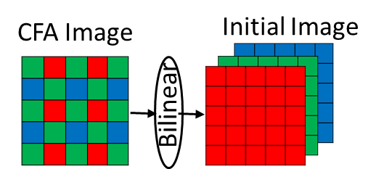
Original 3-stage Structure

Slide 10
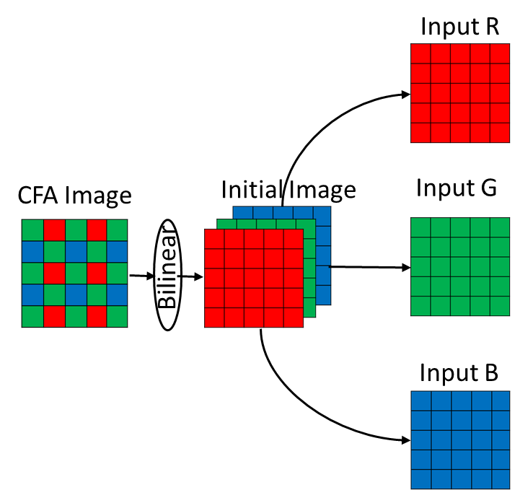
Original 3-stage Structure

Slide 11
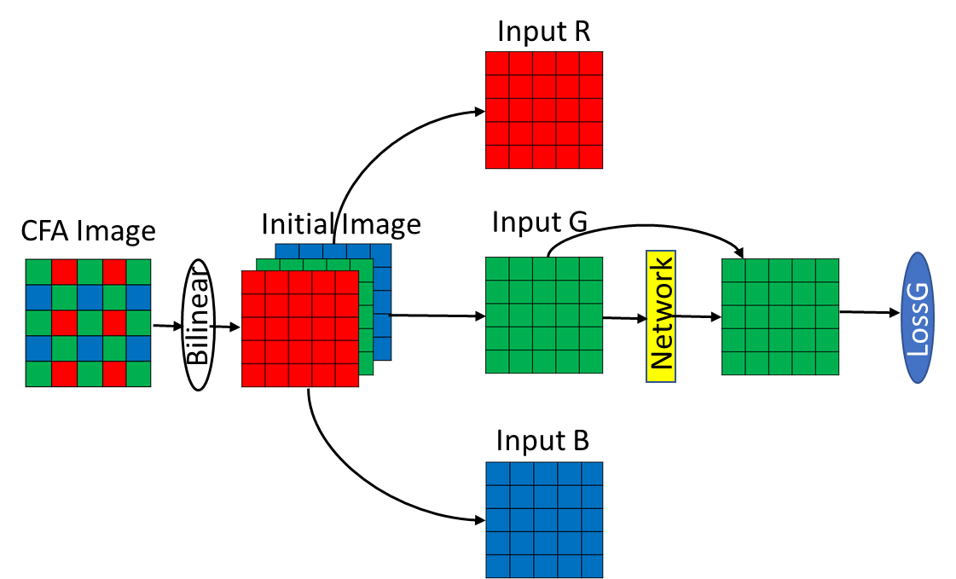
Original 3-stage Structure

Slide 12
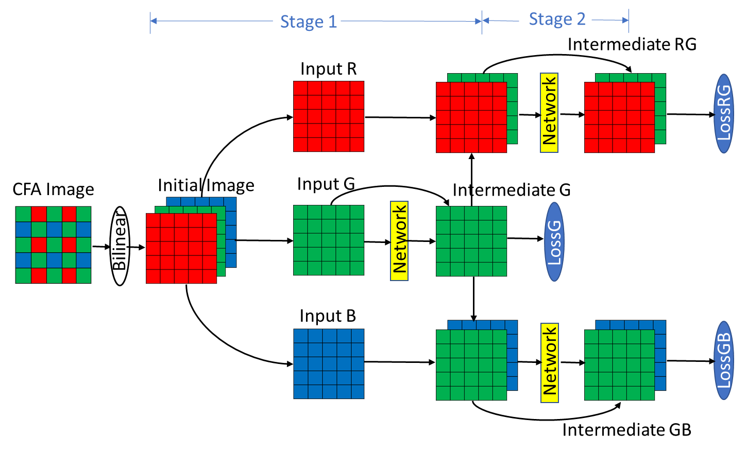
Original 3-stage Structure

Slide 13
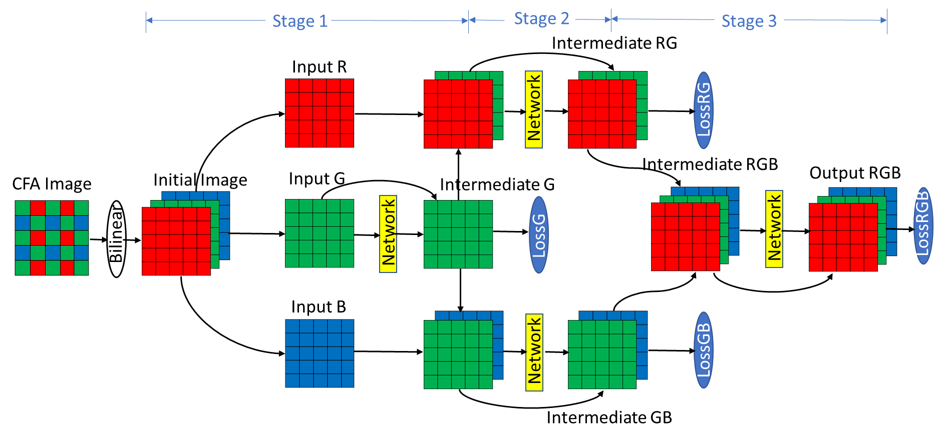
Original 3-stage Structure

Slide 14
Original 3-stage structure-Network
Convolution
128 3x3filters
Relu activation
CR block
Input
CBR block
N
E
T
W
O
R
K
Convolution
128 3x3 filters
CBR block
Batch Normalization
CBR block
Relu activation
C block
Convolution
Stage number 3x3 filters
Output
C- Convolution
B- Batch-Normalization
R- Relu activation
Stage number-1,2,3

Slide 15
Agenda
Introduction
Motivation
Original 3-stage Structure
Sub-pixel based Structure
Experiments
Experiments on Network Model
Experiments on Datasets
Self-ensemble Algorithm
Comparison of Models
Conclusions & Future plans

Slide 16
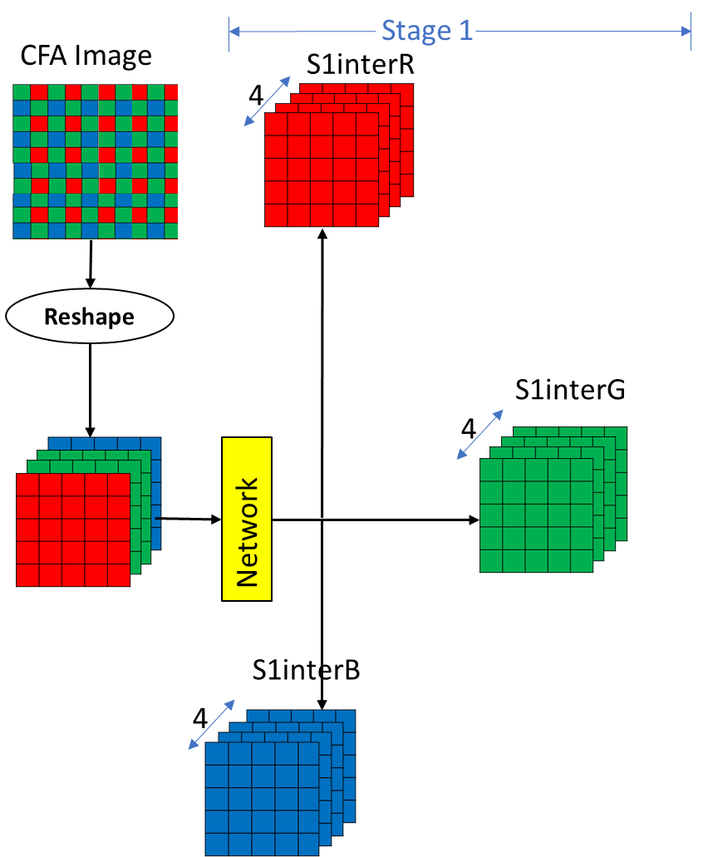
Sub-pixel based structure

Slide 17
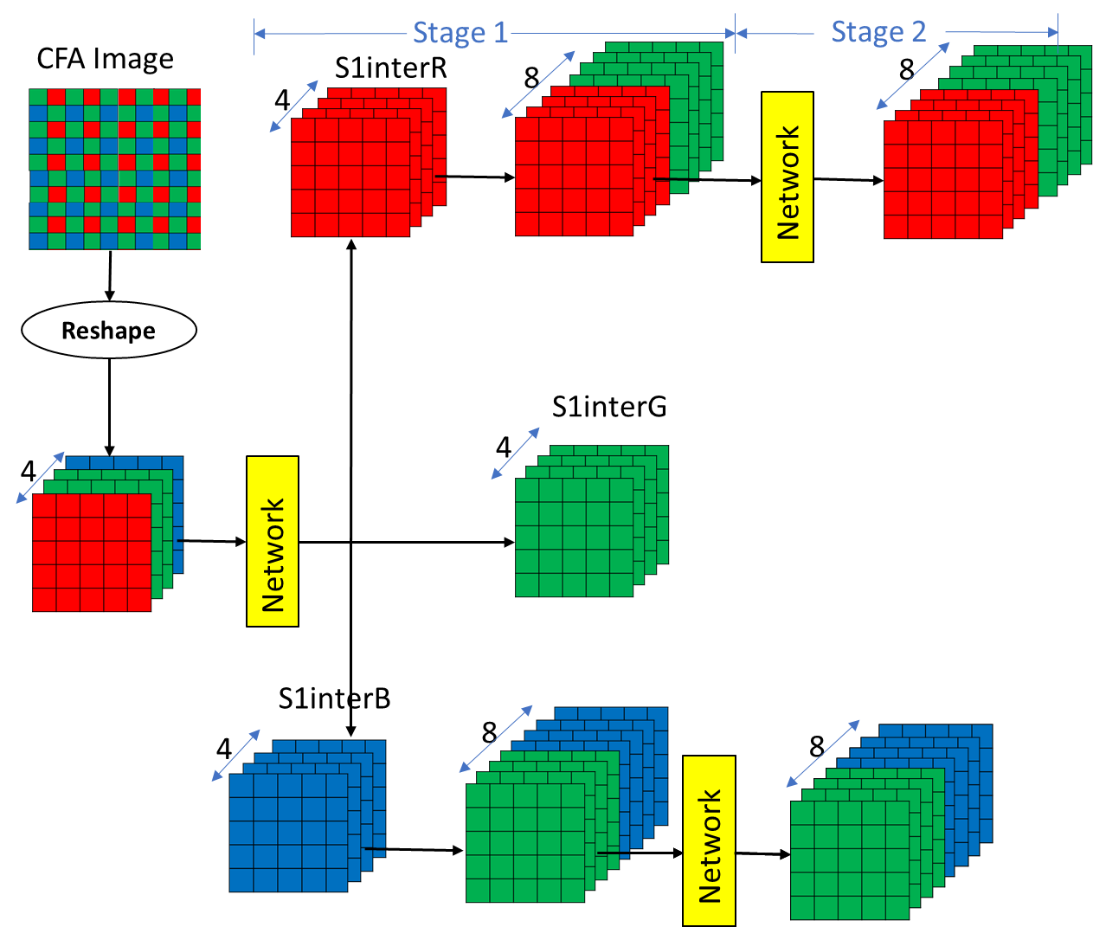
Sub-pixel based structure

Slide 18
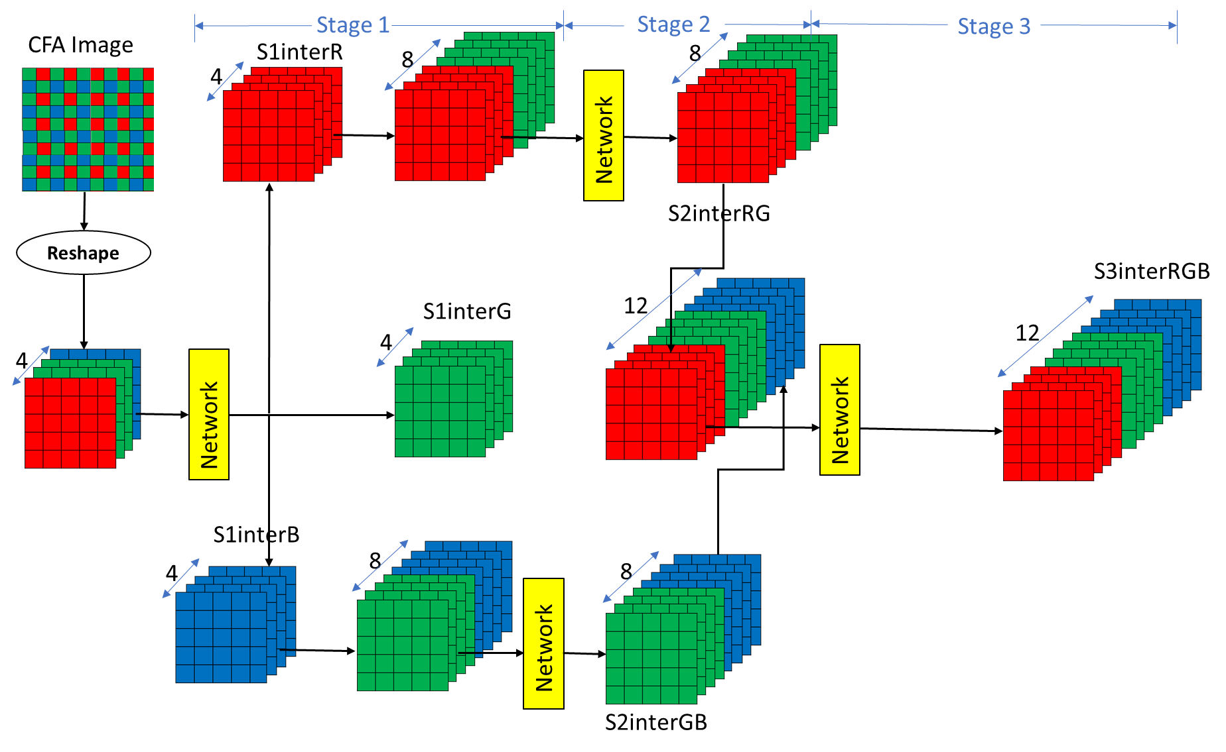
Sub-pixel based structure

Slide 19
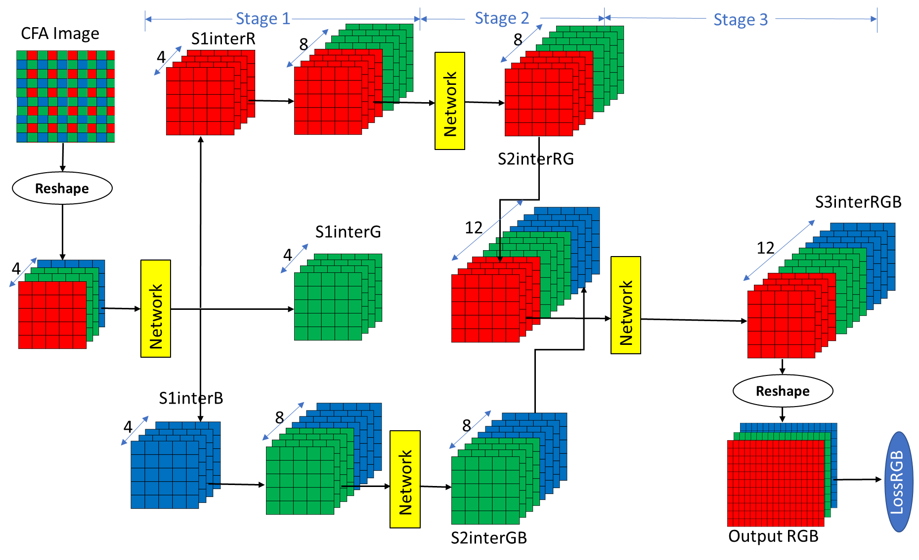
Sub-pixel based structure

Slide 20
Sub-pixel based Network– 128 Filters
Convolution
128 3x3
filters
Relu activation
CR block
Input
CBR block
N
E
T
W
O
R
K
Convolution
128 3x3 filters
CBR block
Batch Normalization
CBR block
Relu activation
C block
Convolution
output blocks 3x3 filters
Output
C- Convolution
B- Batch-Normalization
R- Relu activation
Output blocks-12,8,12

Slide 21
Sub-pixel based Network– Double Resnet
Additional resnet connection between layer 1 and layer 4
CR block(filters)
Input
CBR block(filters)
N
E
T
W
O
R
K
Stack layer
CBR block(filters)
CR block output
CBR-3 block output
CBR block(filters)
C block(output blocks)
Output
C- Convolution
B- Batch-Normalization
R- Relu activation
filters-128
output blocks-12,8,12

Slide 22
Sub-pixel based Network– 64 Filters
Made the network deeper by increasing number of CBR blocks and reduce number of filters .
Convolution
64 3x3filters
Relu activation
CR block
Input
CBR block
N
E
T
W
O
R
K
Convolution
64 3x3 filters
8
Batch Normalization
CBR block
Relu activation
C block
Convolution
Output blocks 3x3 filters
Output
C- Convolution
B- Batch-Normalization
R- Relu activation
Output blocks-12,8,12

Slide 23
Sub-pixel based Network– Inception
Pass input to deep and wide network and let network decides what it should learn from both of them
Convolution
128 3x3 filters
Convolution
64 3x3 filters
CR block(filters)
Input
Inception block
Convolution
64 3x3 filters
N
E
T
W
O
R
K
Inception block
Convolution
192 3x3 filters
Inception block
Batch Normalization
Batch Normalization
C block(output blocks)
Relu activation
Output
C- Convolution
B- Batch-Normalization
R- Relu activation
filters-128
Output blocks-12,8,12

Slide 24
Sub-pixel based Network– Double Resnet + Inception
Additional resnet connection between layer 1 and layer 4 in the inception block
CR block(filters)
Input
Inception block(filters)
N
E
T
W
O
R
K
Stack layer
Inception block(filters)
CR block output
CBR-3 block output
Inception block(filters)
C block(output blocks)
Output
C- Convolution
B- Batch-Normalization
R- Relu activation
filters-128
Output blocks-12,8,12

Slide 25
Sub-pixel based Network– Group convolution
Split input into groups, perform separate convolution and concatenate the output
CR block(filters)
Input
Group convolution
Group convolution block
N
E
T
W
O
R
K
Batch Normalization
Group convolution bock
Relu activation
Group convolution block
C block(output blocks)
Output
C- Convolution
B- Batch-Normalization
R- Relu activation
filters-128
Output blocks-12,8,12

Slide 26
Group convolution
convolution block
Input
concat
output
convolution block

Slide 27
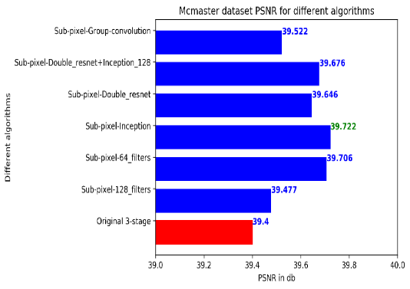
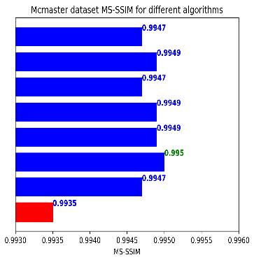
Results
Output PSNR & MS-SSIM comparison – Mcmaster dataset
Notes:
Least – 0.08db improvement
Max-0.32db improvement
Others-between 0.24 and 0.28db improvement.

Slide 28
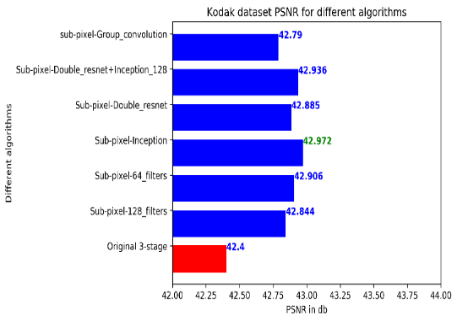
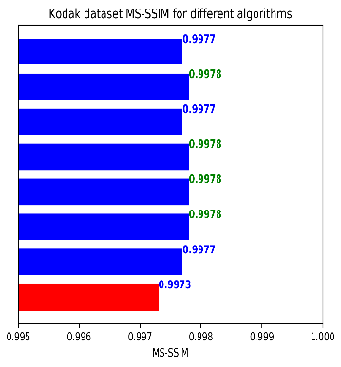
Results
Output PSNR & MS-SSIM comparison – Kodak dataset
Notes:
Least – 0.44db improvement
Max-0.57db improvement
Others between 0.48 to 0.53db improvement.

Slide 29
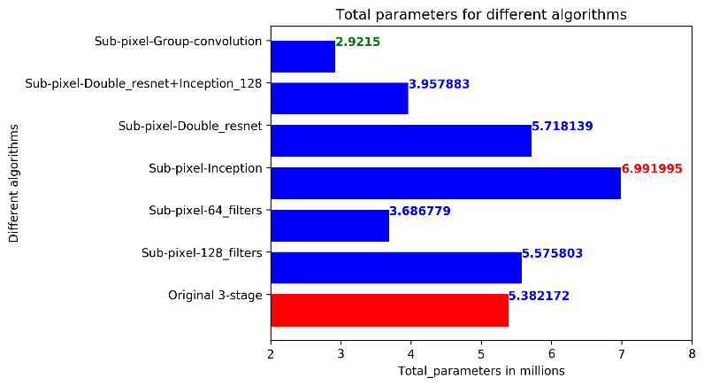
Results
Total-parameters comparison
Notes:
Max- 6.9 million
Min-3.6 million

Slide 30
Agenda
Introduction
Motivation
Original 3-stage Structure
Sub-pixel based Structure
Experiments
Experiments on network Model
Experiments on Datasets
Self-ensemble Algorithm
Comparison of Models
Conclusions & Future plans

Slide 31
Sub-pixel based Network– 64 Filters
Made the network deeper by increasing number of CBR blocks and reduce number of filters .
Convolution
64 3x3filters
Relu activation
CR block
Input
CBR block
N
E
T
W
O
R
K
Convolution
64 3x3 filters
8
Batch Normalization
CBR block
Relu activation
C block
Convolution
Output blocks 3x3 filters
Output
C- Convolution
B- Batch-Normalization
R- Relu activation
Output blocks-12,8,12

Slide 32
Sub-pixel 64-Filters with Improvement

Slide 33
Sub-pixel 64-Filters with Improvement

Slide 34
Sub-pixel 64-Filters with Improvement

Slide 35
Sub-pixel 64-Filters with Improvement

Slide 36
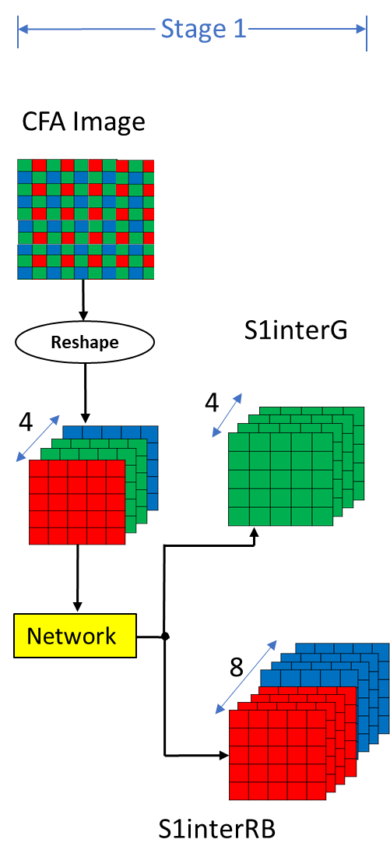
Sub-pixel 64 Filters with extra RB Network

Slide 37
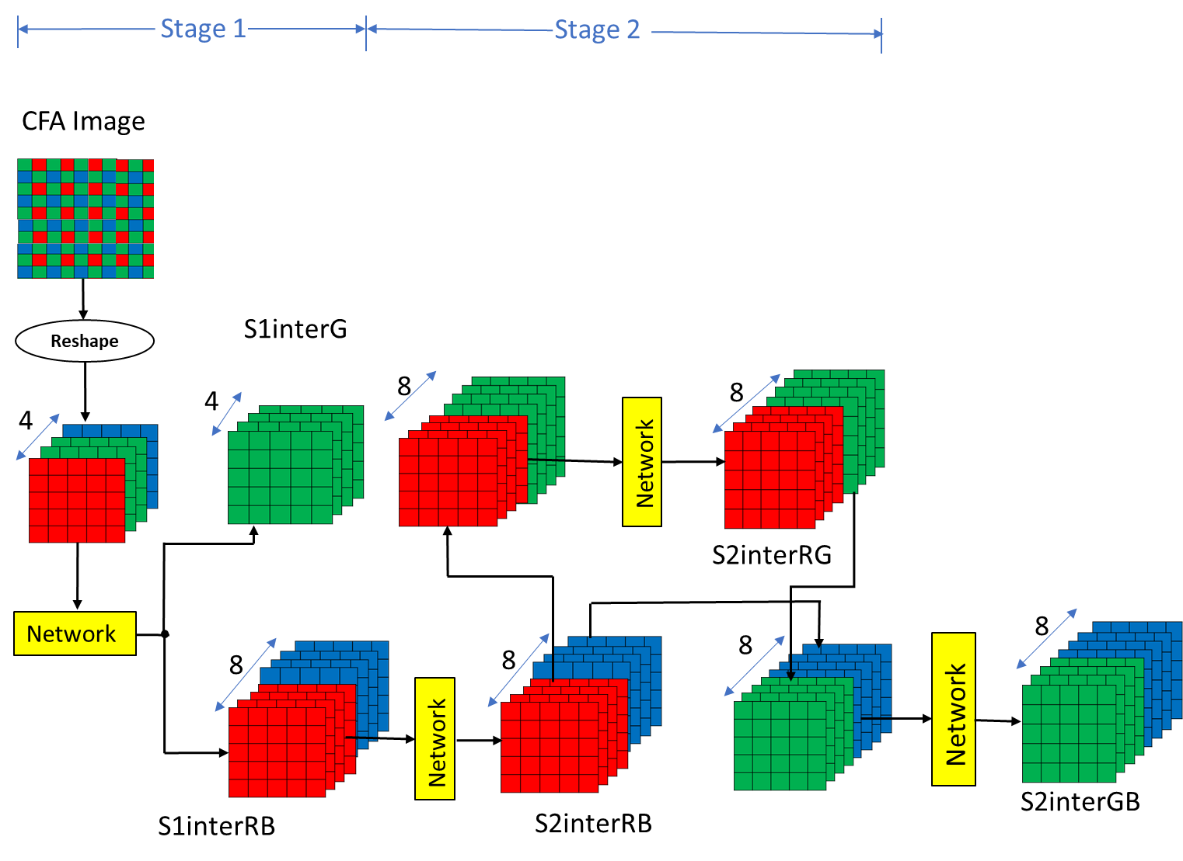
Sub-pixel 64 Filters with extra RB Network

Slide 38
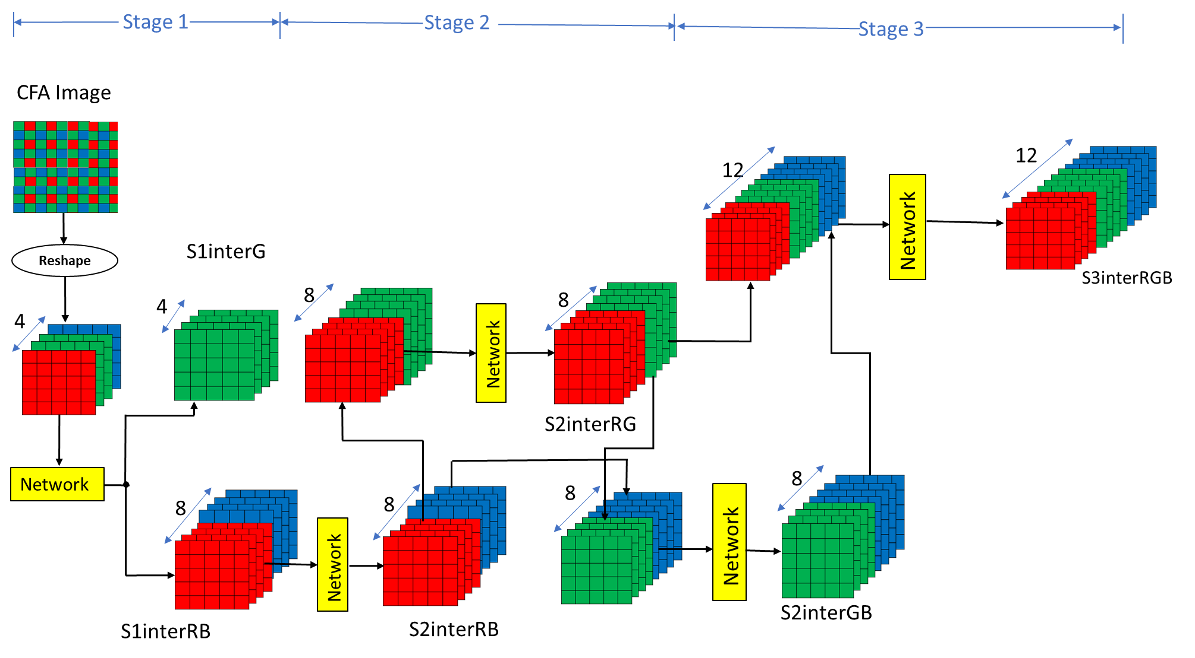
Sub-pixel 64 Filters with extra RB Network

Slide 39
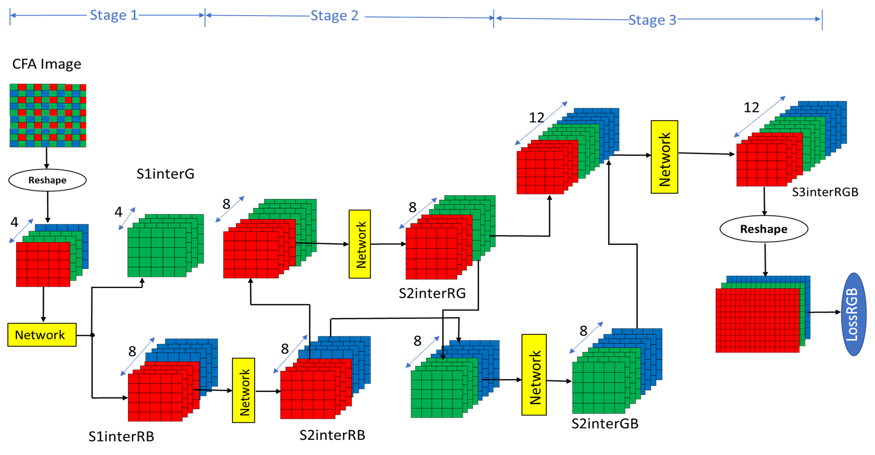
Sub-pixel 64 Filters with extra RB Network

Slide 40
Sub-pixel – 64 Filters with Deeper Third Stage
Decrease the number of CBR blocks from 8 to 5 in 2nd stage and increase from 8 to 14 in 3rd stage.
Convolution
64 3x3filters
Relu activation
CR block
Input
CBR block
N
E
T
W
O
R
K
Convolution
64 3x3 filters
N
Batch Normalization
CBR block
Relu activation
C block
Convolution
Output blocks 3x3 filters
Output
C- Convolution
B- Batch-Normalization
R- Relu activation
Output blocks-12,8,12
N-8,5,16

Slide 41
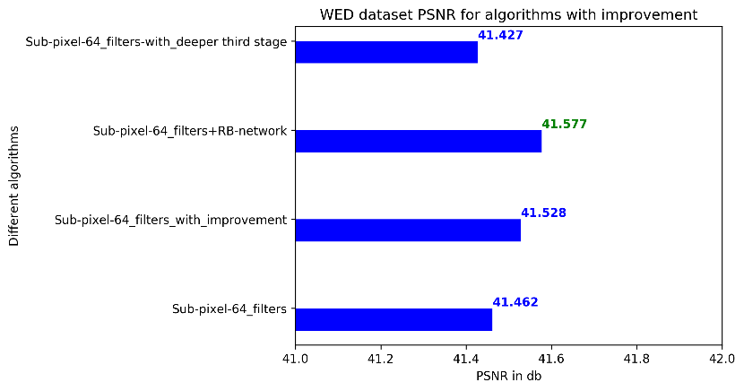
Results
Notes:
Max- 6.9 million
Min-3.6 million

Slide 42
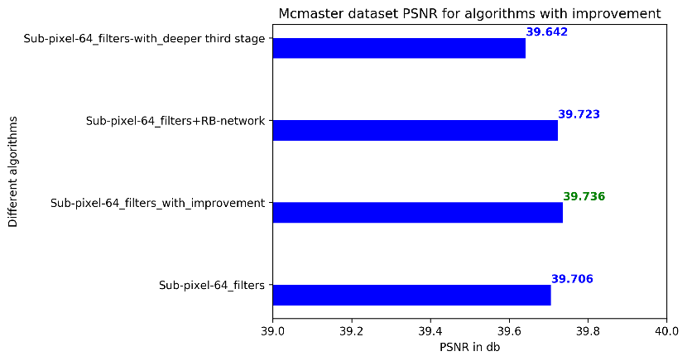
Results
Notes:
Max- 6.9 million
Min-3.6 million

Slide 43
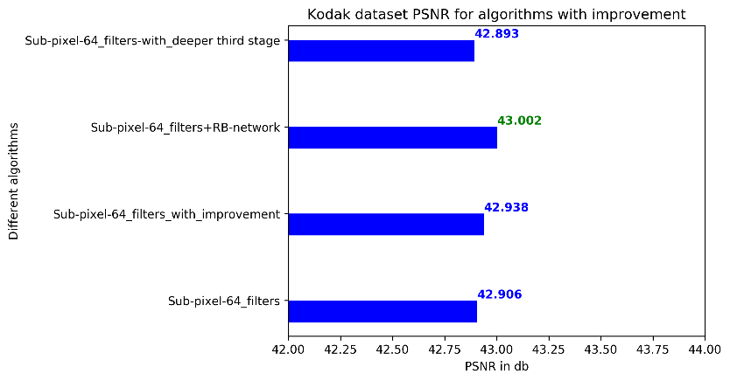
Results
Notes:
Max- 6.9 million
Min-3.6 million

Slide 44
Agenda
Introduction
Motivation
Original 3-stage Structure
Sub-pixel based Structure
Experiments
Experiments on Network Model
Experiments on Datasets
Self-ensemble Algorithm
Comparison of Models
Conclusions & Future plans

Slide 45
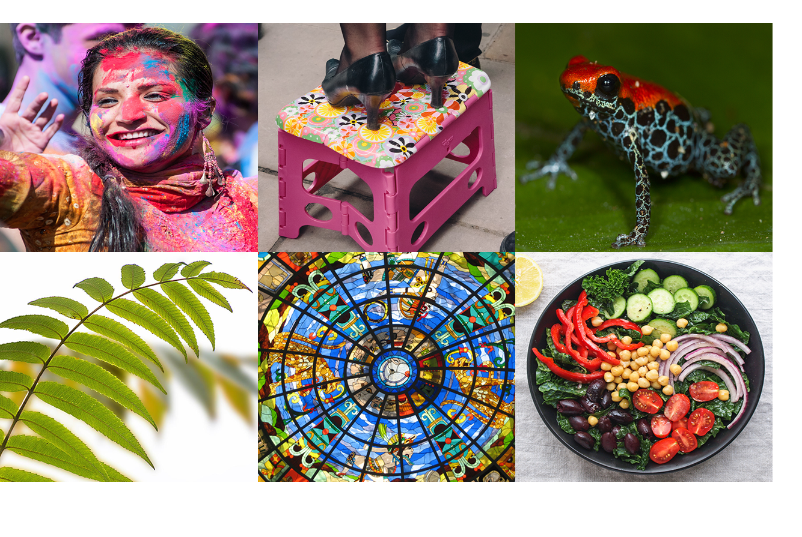
Flickr500 Dataset
500 colorful images with less inter-channel correlation
500 + 4644 WED images used for training
Used Sub-pixel double resnet+ inception model to train
Image source: http://www.cmlab.csie.ntu.edu.tw/project/Deep-Demosaic/

Slide 46
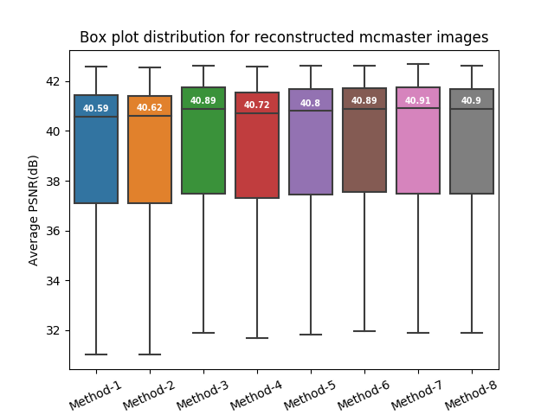
Low PSNR Image Improvement Dataset
Method-1- original 3-stage structure
Method-2- Sub-pixel 128 filters
Method-3- Sub-pixel inception
Method-4- Sub-pixel group- convolution
Method-5- Sub-pixel double- resnet
Method-6 Sub-pixel double- resnet+inception
Method-7- Sub-pixel 64 filters with improvement
Method-8- Sub-pixel 64 filters+RB network

Slide 47
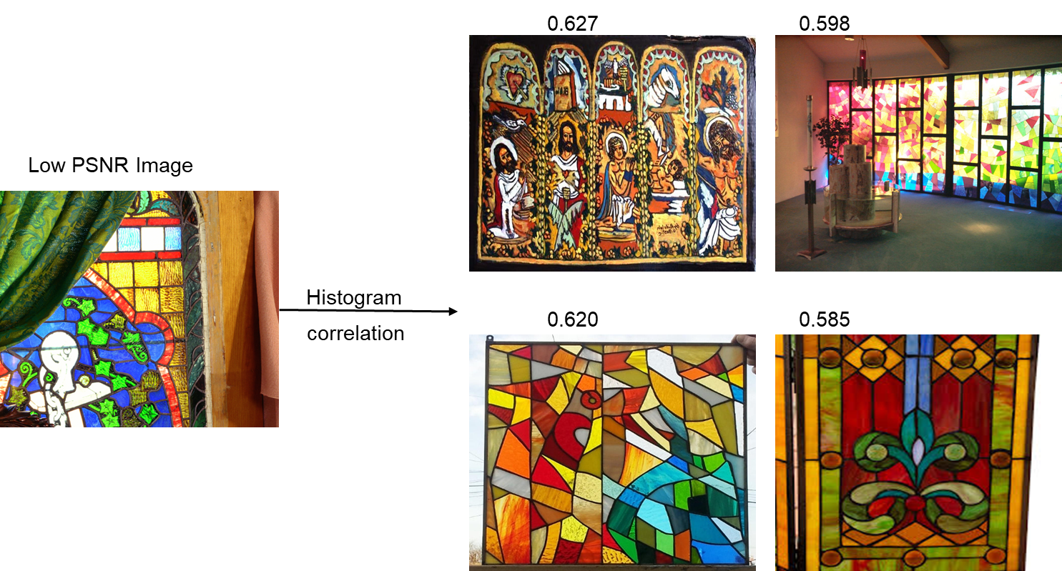
Low PSNR Image Improvement Dataset
Top 100 images from image search are selected.
45/100 images selected for training based on histogram correlation.
Sub-pixel 64-filters with improvement model is used for training.

Slide 48
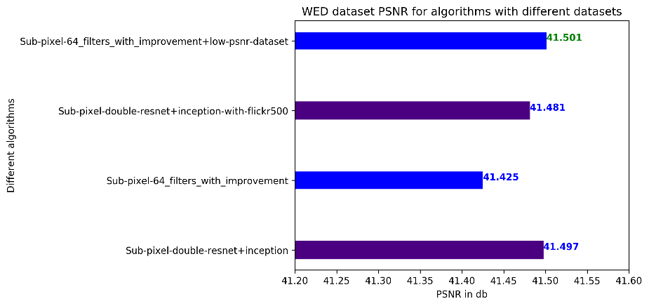
Results
Notes:
Max- 6.9 million
Min-3.6 million

Slide 49
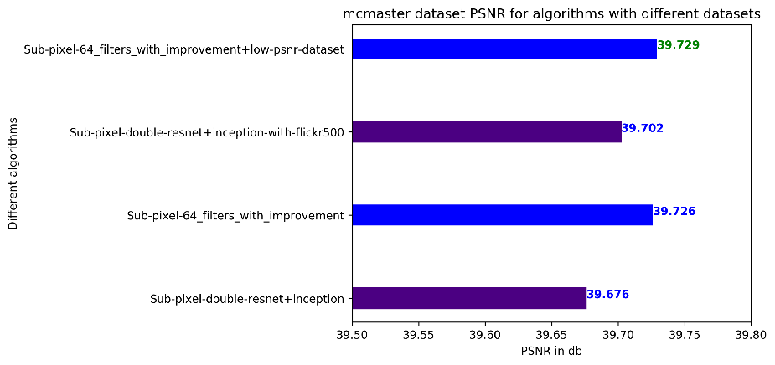
Results
Notes:
Max- 6.9 million
Min-3.6 million

Slide 50
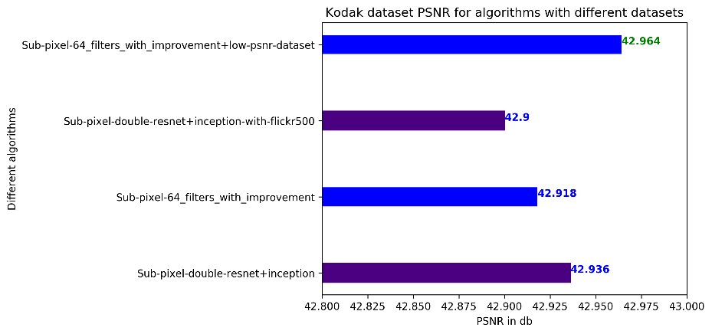
Results
Notes:
Max- 6.9 million
Min-3.6 million

Slide 51
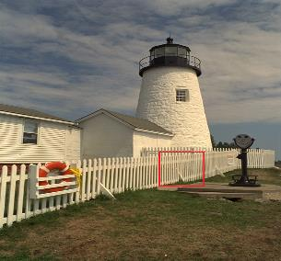

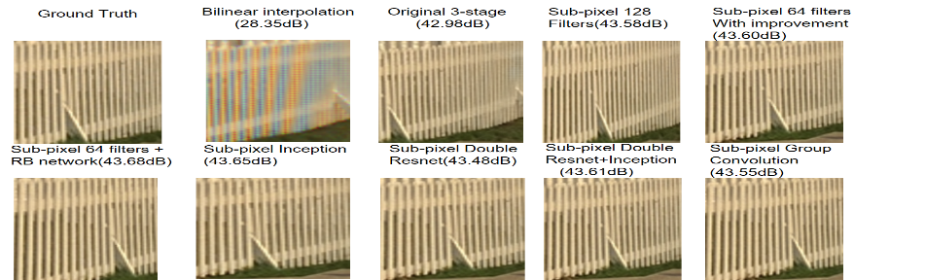
Results

Slide 52
Agenda
Introduction
Motivation
Original 3-stage Structure
Sub-pixel based Structure
Experiments
Experiments on Network Model
Experiments on Datasets
Self-ensemble Algorithm
Comparison of Models
Conclusions & Future plans

Slide 53
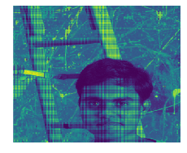
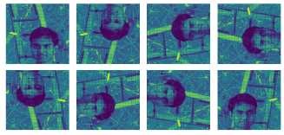
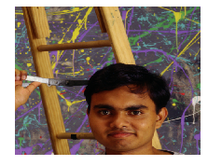
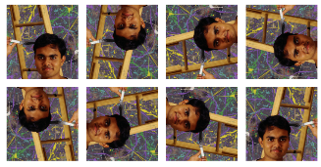
Self-ensemble Algorithm
CFA Input
Original + augmented CFA
CFA Input
3-Stage
N
E
T
W
O
R
K
Input
creation
Ensemble output
Ensembled demosaiced output image
Original + augmented reconstructed demosaiced Images

Slide 54
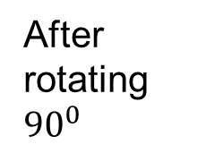
Self-ensemble Algorithm
Two ways to perform ensemble algorithm
Pass each version of the image serially one by one.
Pre-process the image and pass all the 8 version of the image in parallel.
G | R | G | R
B | G | B | G
G | R | G | R
B | G | B | G
R | G | R | G
G | B | G | B
R | G | R | G
G | B | G | B
After rotating ${90}^{0}$
G | R
B | G
G | R
B | G
G | R | G | R
B | G | B | G
G | R | G | R
B | G | B | G
Pad
Padded values

Slide 55
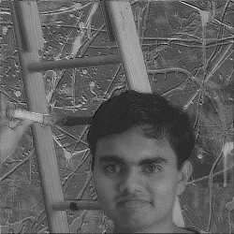
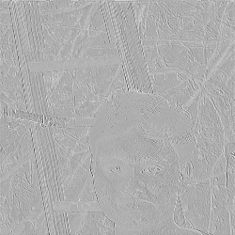
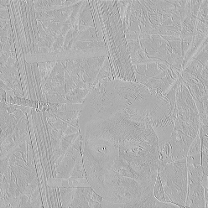
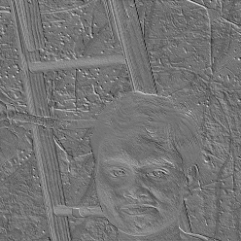
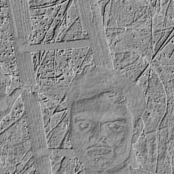
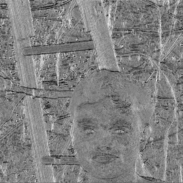
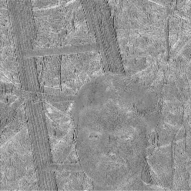


Stage-3 13th Filter Feature Map Outputs Layer 1-9

Slide 56


Results
With Ensemble
Without Ensemble

Slide 57
Results
Notes:
Max- 6.9 million
Min-3.6 million

Slide 58
Results
Notes:
Max- 6.9 million
Min-3.6 million

Slide 59
Agenda
Introduction
Motivation
Original 3-stage Structure
Sub-pixel based Structure
Experiments
Experiments on Network Model
Experiments on Datasets
Self-ensemble Algorithm
Comparison of Models
Conclusions & Future plans

Slide 60


Comparison of Models

Slide 61


Comparison of Models

Slide 62
Agenda
Introduction
Motivation
Original 3-stage Structure
Sub-pixel based Structure
Experiments
Experiments on Network Model
Experiments on Datasets
Self-ensemble Algorithm
Comparison of Models
Conclusions & Future plans

Slide 63

Comparison of Models

Slide 64
Conclusions
Various sub-pixel algorithms are proposed which outperforms original 3-stage structure.
Systems with memory constraints- Sub-pixel group convolution
Less inter-channel correlation - Sub-pixel 64 filters with improvement
More inter-channel correlation – Sub-pixel 64 filters + RB network
More training data - Sub-pixel Inception network.
For improving low PSNR image – More training data with similar features can be added.
Intra-channel can be exploited and can be combined with inter-channel correlation methods proposed.
Future plans

Slide 65

Future plans
Image can be transformed to frequency domain before passing to CNN.

Slide 66
References:
Method-1 source: K. Cui, Z. Jin, E. Steinbach, “Color Image Demosaicking using a 3-stage Convolutional Neural Network Structure”, IEEE International Conference on Image Processing (ICIP 2018), Athens, Greece, Oktober 2018.
R. Tan, K. Zhang, W. Zuo, and L. Zhang, “Color image demosaicking via deep residual learning”, in 2017 IEEE International Conference on Multimedia and Expo (ICME), pp. 793–798.
Christian Szegedy, Wei Liu , Yangqing Jia, Pierre Sermanet, Scott E. Reed, Dragomir Anguelov, Dumitru Erhan, Vincent Vanhoucke, Andrew Rabinovich, “Going deeper with convolutions”, in 2015 IEEE Conference on Computer Vision and Pattern Recognition (CVPR), pp.1-9.
Gao Huang, Zhuang Liu, Laurens van der Maaten, Kilian Q. Weinberger,
“ Densely Connected Convolutional Networks”, in 2017 IEEE Conference on Computer Vision and Pattern Recognition (CVPR), pp 2261-2269.
R. Timofte, R. Rothe, and L. Van Gool. Seven ways to improve example-based single image super resolution. In CVPR 2016.

Slide 67
Thank you ☺

Slide 68

Results
Notes:
Max- 6.9 million
Min-3.6 million

Slide 69

Results
Notes:
Max- 6.9 million
Min-3.6 million

Slide 70

Results
Notes:
Max- 6.9 million
Min-3.6 million

Slide 71

N
E
T
W
O
R
K
Input
DWT
IDWT
output
$$⨁$$
Reconstructed
output

Slide 72

Sub-pixel based structure with extra RB Network

Slide 73

Sub-pixel based structure with extra RB Network

Slide 74

Sub-pixel based structure with extra RB Network

Slide 75

Sub-pixel based structure with extra RB Network

Slide 76


Slide 77

Sub-pixel 64-Filters with Improvement

Slide 78

Sub-pixel 64-Filters with Improvement

Slide 79

Sub-pixel 64-Filters with Improvement

Slide 80

Sub-pixel 64-Filters with Improvement

Slide 81

Comparison of Models

Slide 82
Comparison of Models

Slide 83

Comparison of Models

Slide 85

Comparison of Models

